Slide 1
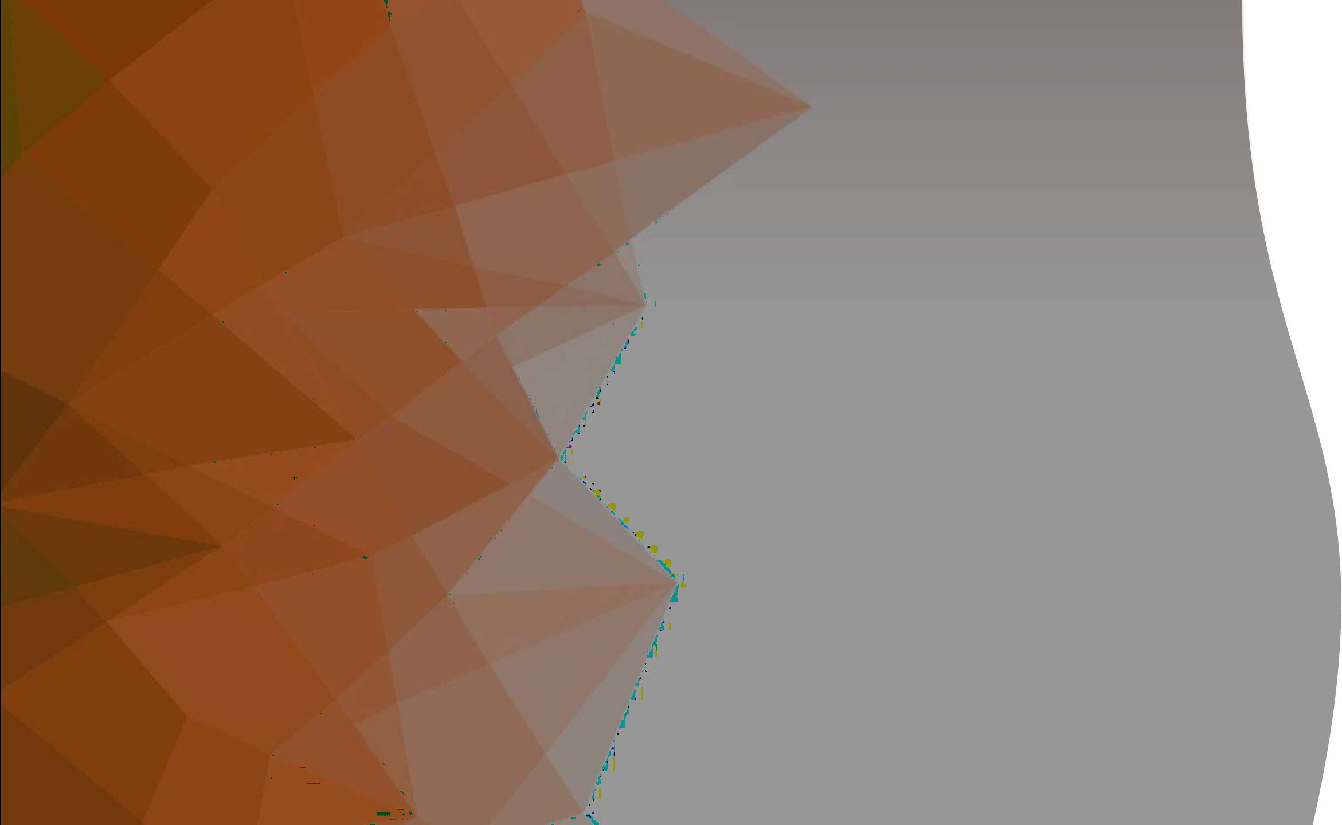
VIBEATHON
Team Members:
Anubhav
Tejus
Karthik
Arjav
Akshay

Slide 2
About Problem
Fragmented Event Management: Scattered tools make coordination messy and error-prone.
Inefficient Communication: Silos cause delays and missed updates.
Lack of Real-Time Control: Hard to adapt to last-minute changes without live tracking.
Post-Event Gaps: Manual processes reduce engagement after the event.

Slide 3
EventOps: Your AI EventManager
Smart Tasks – Stage-wise tracking with reminders & checklists.
Vendor Hub – Centralized vendor & resource coordination.
Team Management – Assign & monitor volunteers, speakers, schedules.
Dynamic Agenda – Real-time session updates & bulk uploads.
Feedback & Insights – Collect, analyze, and act on event feedback.
Auto Certificates – One-click generation & distribution.
Photo Gallery – Share event highlights seamlessly.

Slide 4
Technology Stack
Frontend
Framework: ReactJS
Language: TypeScript
Styling: Tailwind CSS + Radix UI Components
State Management: Redux
Backend & APIs
Database: Supabase (PostgreSQL)
Authentication: Supabase
File Storage: Supabase Storage
AI Services:
Google Gemini (Text generation & analysis)

Slide 5
Use Case
Seamless Coordination :A unified hub for managing tasks, vendors, volunteers, and speakers in one place.
Agile Planning : Dynamic agenda builder with real-time updates keeps events on track.
Effortless Engagement : Automated feedback collection and analytics drive smarter decisions.
Smart Recognition : Instant generation of personalized certificates and thank-you emails.
Lasting Memories : Integrated photo galleries that connect participants beyond the event.

Slide 6
Show Stopper
Smart Task Orchestration: Track tasks, get reminders, and monitor progress in real-time.
Unified Resource & Vendor Hub: Manage vendors, assets, and documents all in one place.
People-Centric Management: Seamlessly handle roles, responsibilities, and logistics.
Automated Recognition: Generate certificates and thank-you notes instantly.
Memorable Moments, Organized: Share and link event photos effortlessly.

